Slide 1

Notes:
HIPPA COMPLIANCE Health Insurance Portability and Accountability Act By: Sanjeev . Singh .Bharwan

Slide 2
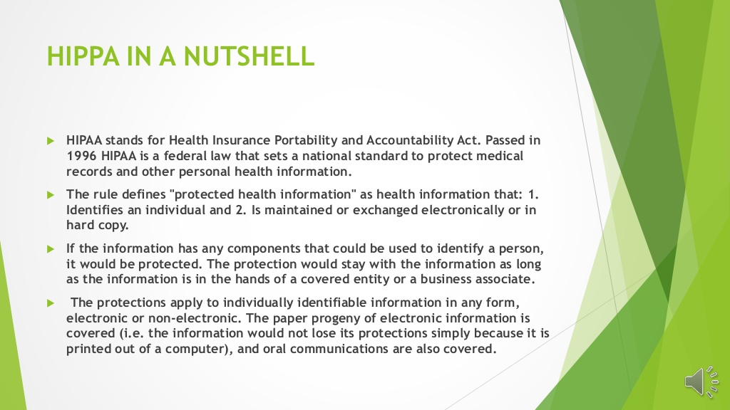
Notes:
HIPPA IN A NUTSHELL ïµ HIPAA stands for Health Insurance Portability and Accountability Act. Passed in 1996 HIPAA is a federal law that sets a national standard to protect medical records and other personal health information. ïµ The rule defines &protected health information& as health information that: 1. Identifies an individual and 2. Is maintained or exchanged electronically or in hard copy. ïµ If the information has any components that could be used to identify a person, it would be protected. The protection would stay with the information as long as the information is in the hands of a covered entity or a business associate. ïµ The protections apply to individually identifiable information in any form, electronic or non-electronic. The paper progeny of electronic information is covered (i.e. the information would not lose its protections simply because it is printed out of a computer), and oral communications are also covered.

Slide 3
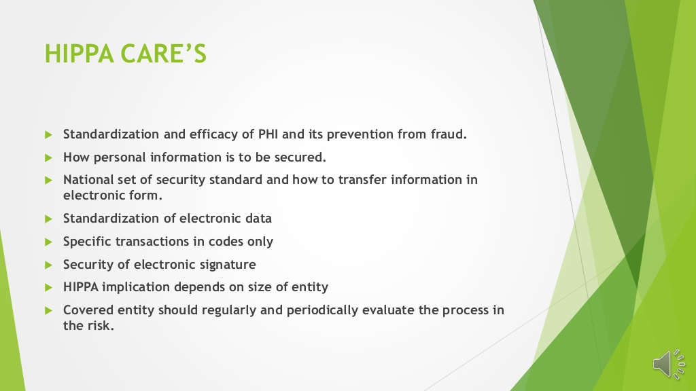
Notes:
HIPPA CARES ïµ Standardization and efficacy of PHI and its prevention from fraud. ïµ How personal information is to be secured. ïµ National set of security standard and how to transfer information in electronic form. ïµ Standardization of electronic data ïµ Specific transactions in codes only ïµ Security of electronic signature ïµ HIPPA implication depends on size of entity ïµ Covered entity should regularly and periodically evaluate the process in the risk.

Slide 4
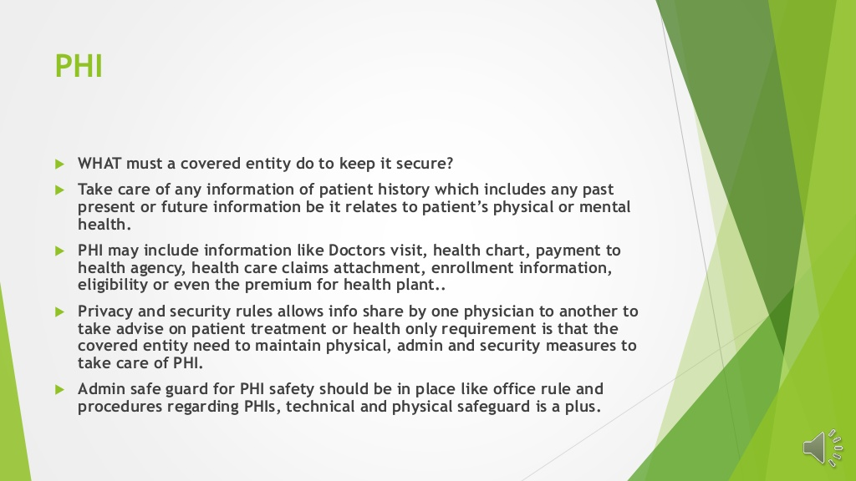
Notes:
PHI ïµ WHAT must a covered entity do to keep it secure? ïµ Take care of any information of patient history which includes any past present or future information be it relates to patients physical or mental health. ïµ PHI may include information like Doctors visit, health chart, payment to health agency, health care claims attachment, enrollment information, eligibility or even the premium for health plant.. ïµ Privacy and security rules allows info share by one physician to another to take advise on patient treatment or health only requirement is that the covered entity need to maintain physical, admin and security measures to take care of PHI. ïµ Admin safe guard for PHI safety should be in place like office rule and procedures regarding PHIs, technical and physical safeguard is a plus.

Slide 5
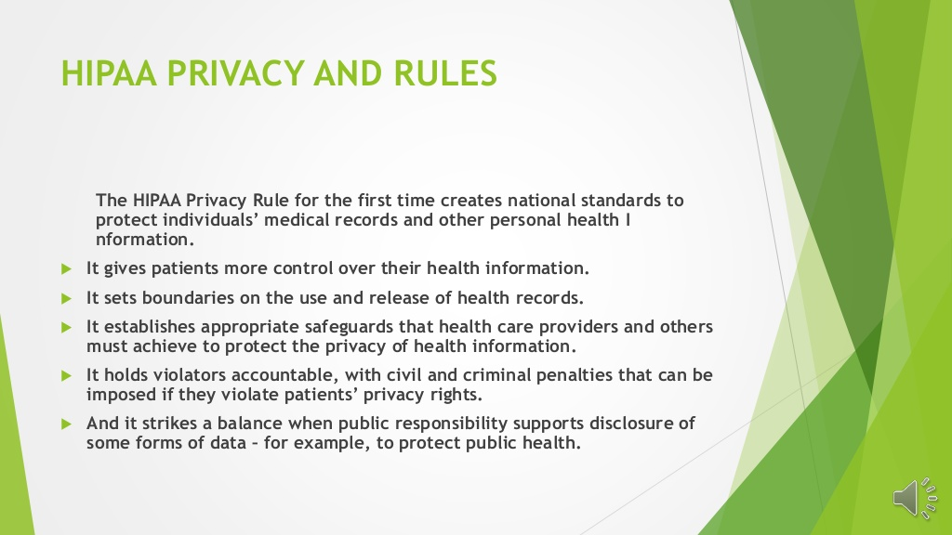
Notes:
HIPAA PRIVACY AND RULES The HIPAA Privacy Rule for the first time creates national standards to protect individuals medical records and other personal health I nformation. ïµ It gives patients more control over their health information. ïµ It sets boundaries on the use and release of health records. ïµ It establishes appropriate safeguards that health care providers and others must achieve to protect the privacy of health information. ïµ It holds violators accountable, with civil and criminal penalties that can be imposed if they violate patients privacy rights. ïµ And it strikes a balance when public responsibility supports disclosure of some forms of data  for example, to protect public health.

Slide 6
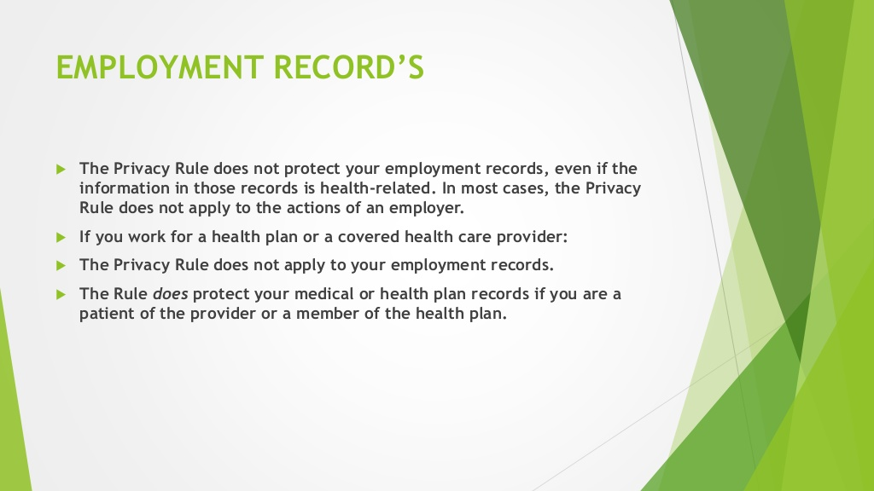
Notes:
EMPLOYMENT RECORDS ïµ The Privacy Rule does not protect your employment records, even if the information in those records is health-related. In most cases, the Privacy Rule does not apply to the actions of an employer. ïµ If you work for a health plan or a covered health care provider: ïµ The Privacy Rule does not apply to your employment records. ïµ The Rule does protect your medical or health plan records if you are a patient of the provider or a member of the health plan.

Slide 7
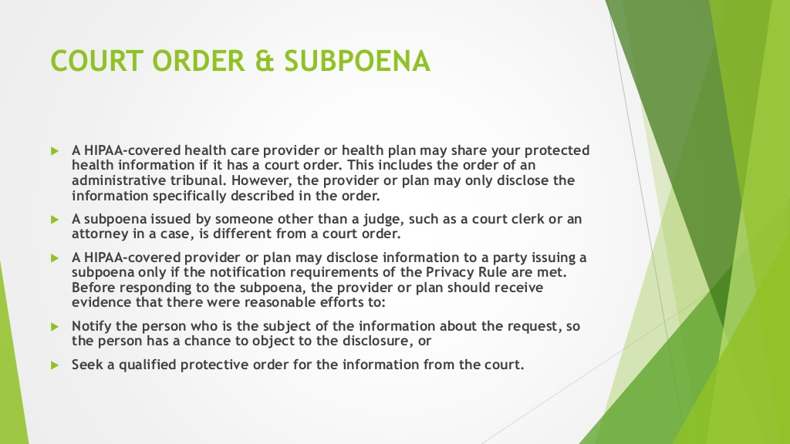
Notes:
COURT ORDER & SUBPOENA ïµ A HIPAA-covered health care provider or health plan may share your protected health information if it has a court order. This includes the order of an administrative tribunal. However, the provider or plan may only disclose the information specifically described in the order. ïµ A subpoena issued by someone other than a judge, such as a court clerk or an attorney in a case, is different from a court order. ïµ A HIPAA-covered provider or plan may disclose information to a party issuing a subpoena only if the notification requirements of the Privacy Rule are met. Before responding to the subpoena, the provider or plan should receive evidence that there were reasonable efforts to: ïµ Notify the person who is the subject of the information about the request, so the person has a chance to object to the disclosure, or ïµ Seek a qualified protective order for the information from the court.

Slide 8
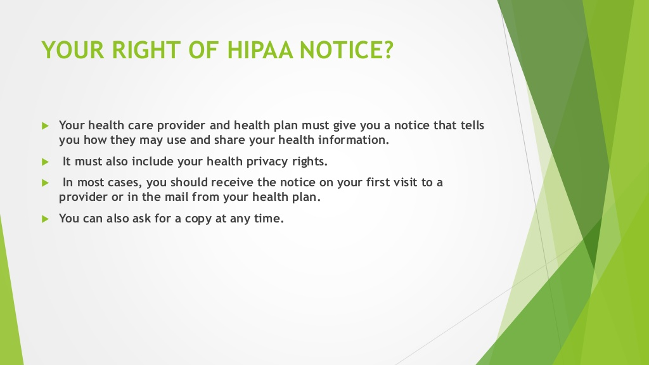
Notes:
YOUR RIGHT OF HIPAA NOTICE? ïµ Your health care provider and health plan must give you a notice that tells you how they may use and share your health information. ïµ It must also include your health privacy rights. ïµ In most cases, you should receive the notice on your first visit to a provider or in the mail from your health plan. ïµ You can also ask for a copy at any time.

Slide 9
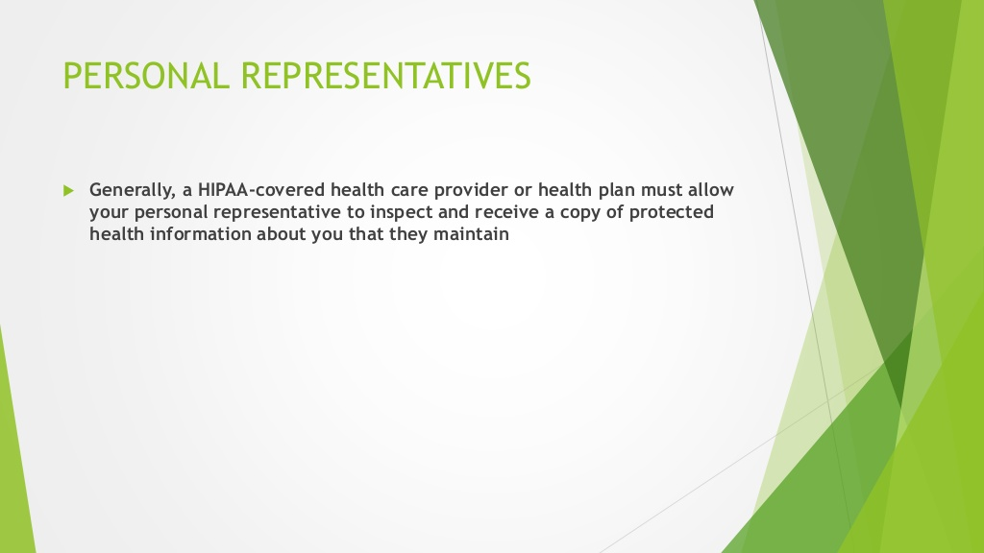
Notes:
PERSONAL REPRESENTATIVES ïµ Generally, a HIPAA-covered health care provider or health plan must allow your personal representative to inspect and receive a copy of protected health information about you that they maintain

Slide 10
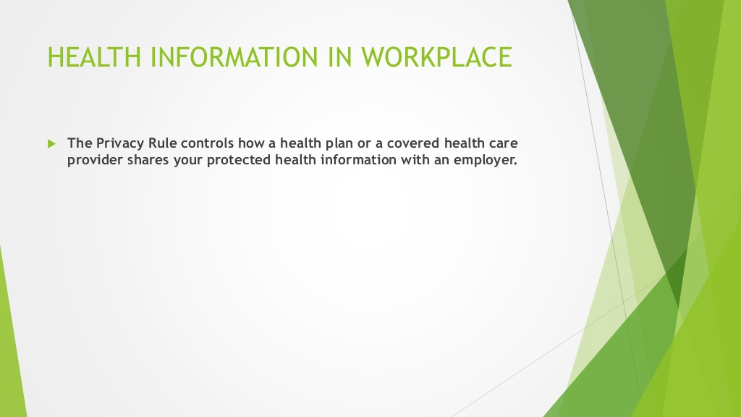
Notes:
HEALTH INFORMATION IN WORKPLACE ïµ The Privacy Rule controls how a health plan or a covered health care provider shares your protected health information with an employer.

Slide 11
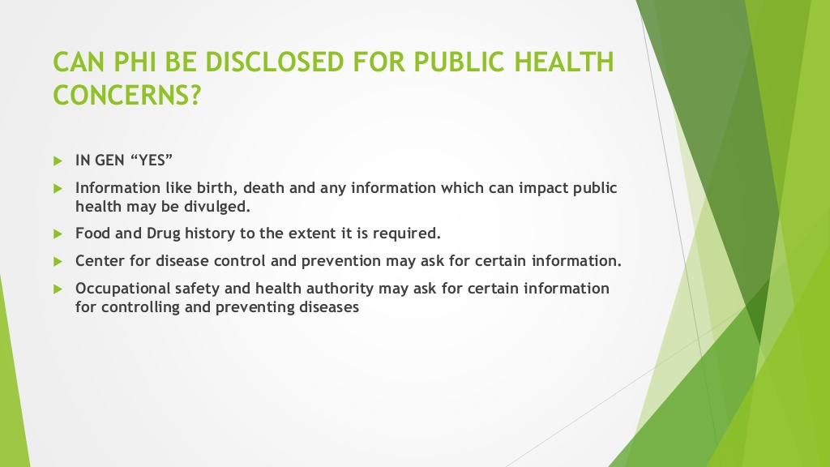
Notes:
CAN PHI BE DISCLOSED FOR PUBLIC HEALTH CONCERNS? ïµ IN GEN YES ïµ Information like birth, death and any information which can impact public health may be divulged. ïµ Food and Drug history to the extent it is required. ïµ Center for disease control and prevention may ask for certain information. ïµ Occupational safety and health authority may ask for certain information for controlling and preventing diseases

Slide 12
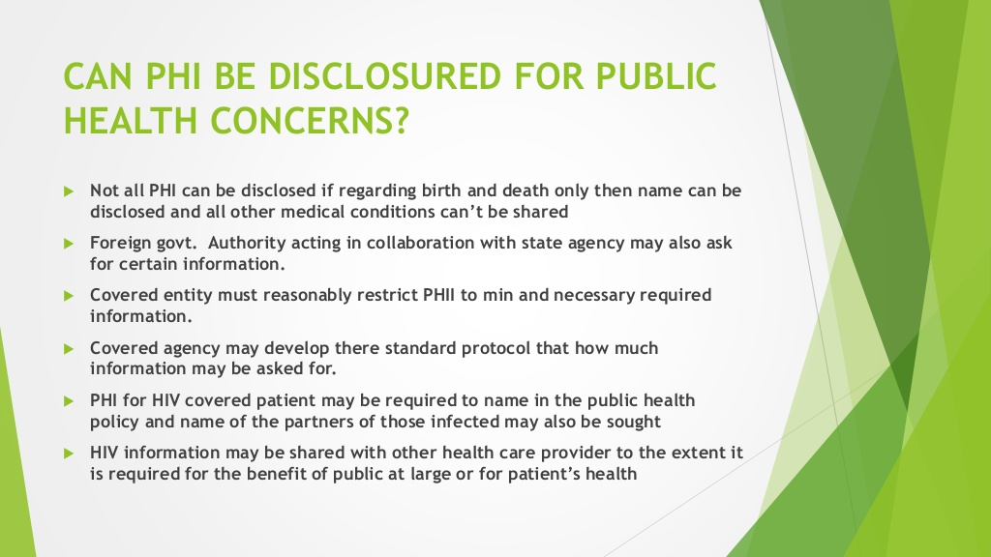
Notes:
CAN PHI BE DISCLOSURED FOR PUBLIC HEALTH CONCERNS? ïµ Not all PHI can be disclosed if regarding birth and death only then name can be disclosed and all other medical conditions cant be shared ïµ Foreign govt. Authority acting in collaboration with state agency may also ask for certain information. ïµ Covered entity must reasonably restrict PHII to min and necessary required information. ïµ Covered agency may develop there standard protocol that how much information may be asked for. ïµ PHI for HIV covered patient may be required to name in the public health policy and name of the partners of those infected may also be sought ïµ HIV information may be shared with other health care provider to the extent it is required for the benefit of public at large or for patients health

Slide 13
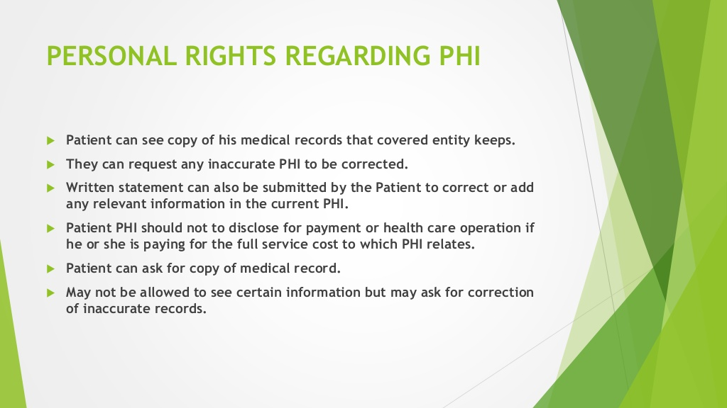
Notes:
PERSONAL RIGHTS REGARDING PHI ïµ Patient can see copy of his medical records that covered entity keeps. ïµ They can request any inaccurate PHI to be corrected. ïµ Written statement can also be submitted by the Patient to correct or add any relevant information in the current PHI. ïµ Patient PHI should not to disclose for payment or health care operation if he or she is paying for the full service cost to which PHI relates. ïµ Patient can ask for copy of medical record. ïµ May not be allowed to see certain information but may ask for correction of inaccurate records.

Slide 14
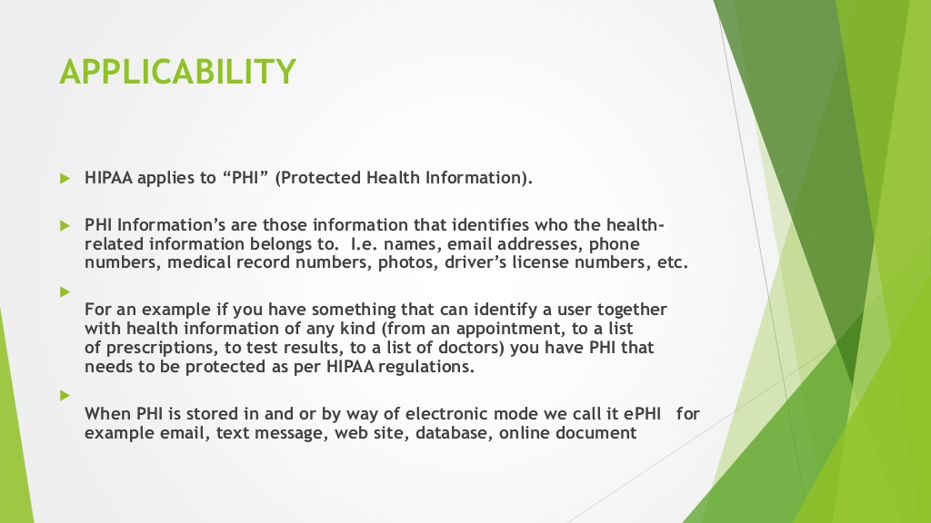
Notes:
APPLICABILITY ïµ HIPAA applies to PHI (Protected Health Information). ïµ PHI Informations are those information that identifies who the health- related information belongs to. I.e. names, email addresses, phone numbers, medical record numbers, photos, drivers license numbers, etc. ïµ For an example if you have something that can identify a user together with health information of any kind (from an appointment, to a list of prescriptions, to test results, to a list of doctors) you have PHI that needs to be protected as per HIPAA regulations. ïµ When PHI is stored in and or by way of electronic mode we call it ePHI for example email, text message, web site, database, online document

Slide 15
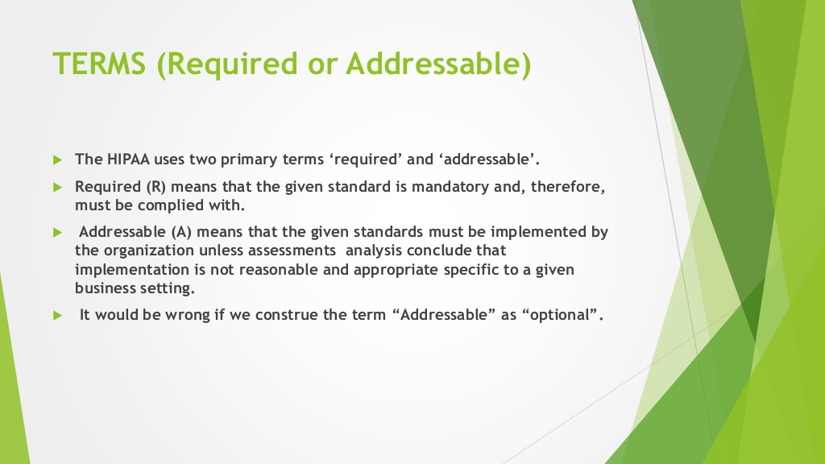
Notes:
TERMS (Required or Addressable) ïµ The HIPAA uses two primary terms required and addressable. ïµ Required (R) means that the given standard is mandatory and, therefore, must be complied with. ïµ Addressable (A) means that the given standards must be implemented by the organization unless assessments analysis conclude that implementation is not reasonable and appropriate specific to a given business setting. ïµ It would be wrong if we construe the term Addressable as optional.

Slide 16
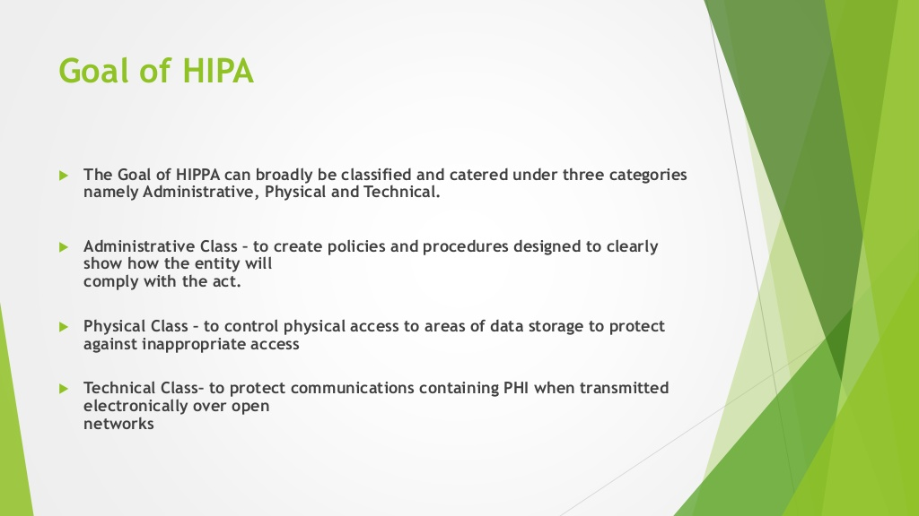
Notes:
Goal of HIPA ïµ The Goal of HIPPA can broadly be classified and catered under three categories namely Administrative, Physical and Technical. ïµ Administrative Class  to create policies and procedures designed to clearly show how the entity will comply with the act. ïµ Physical Class  to control physical access to areas of data storage to protect against inappropriate access ïµ Technical Class to protect communications containing PHI when transmitted electronically over open networks

Slide 17
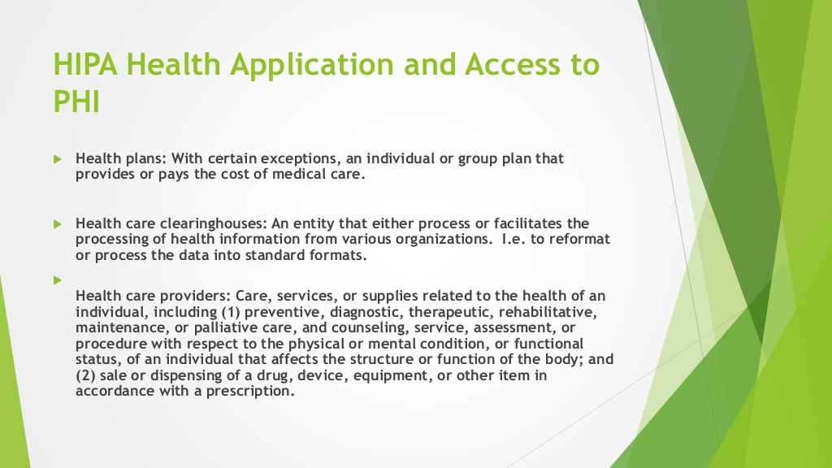
Notes:
HIPA Health Application and Access to PHI ïµ Health plans: With certain exceptions, an individual or group plan that provides or pays the cost of medical care. ïµ Health care clearinghouses: An entity that either process or facilitates the processing of health information from various organizations. I.e. to reformat or process the data into standard formats. ïµ Health care providers: Care, services, or supplies related to the health of an individual, including (1) preventive, diagnostic, therapeutic, rehabilitative, maintenance, or palliative care, and counseling, service, assessment, or procedure with respect to the physical or mental condition, or functional status, of an individual that affects the structure or function of the body; and (2) sale or dispensing of a drug, device, equipment, or other item in accordance with a prescription.

Slide 18
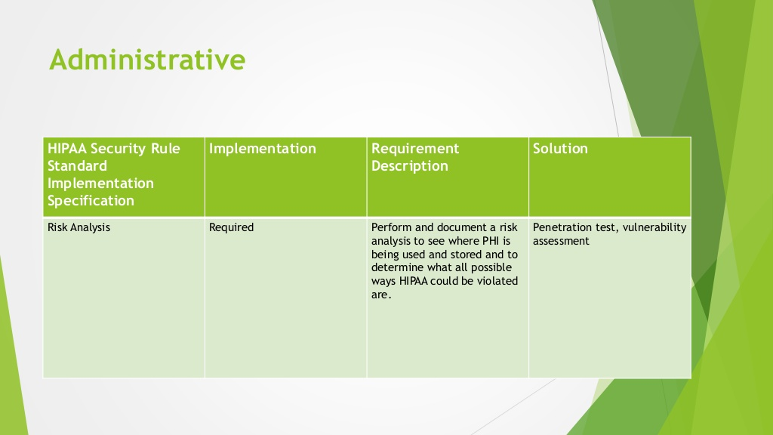
Notes:
Administrative HIPAA Security Rule Standard Implementation Specification Implementation Requirement Description Solution Risk Analysis Required Perform and document a risk analysis to see where PHI is being used and stored and to determine what all possible ways HIPAA could be violated are. Penetration test, vulnerability assessment

Slide 19
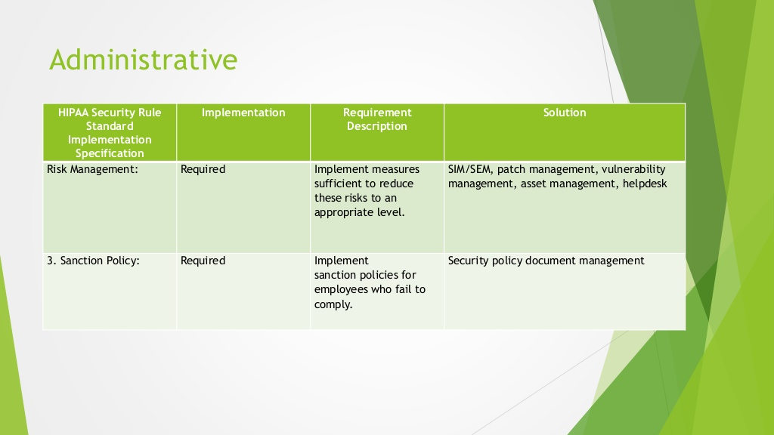
Notes:
Administrative HIPAA Security Rule Standard Implementation Specification Implementation Requirement Description Solution Risk Management: Required Implement measures sufficient to reduce these risks to an appropriate level. SIM/SEM, patch management, vulnerability management, asset management, helpdesk 3. Sanction Policy: Required Implement sanction policies for employees who fail to comply. Security policy document management

Slide 20
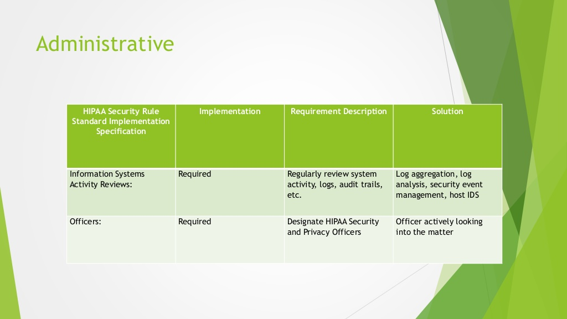
Notes:
Administrative HIPAA Security Rule Standard Implementation Specification Implementation Requirement Description Solution Information Systems Activity Reviews: Required Regularly review system activity, logs, audit trails, etc. Log aggregation, log analysis, security event management, host IDS Officers: Required Designate HIPAA Security and Privacy Officers Officer actively looking into the matter

Slide 21
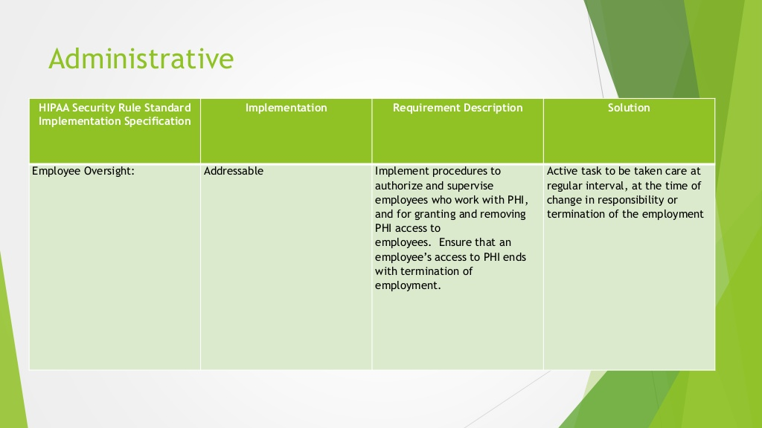
Notes:
Administrative HIPAA Security Rule Standard Implementation Specification Implementation Requirement Description Solution Employee Oversight: Addressable Implement procedures to authorize and supervise employees who work with PHI, and for granting and removing PHI access to employees. Ensure that an employees access to PHI ends with termination of employment. Active task to be taken care at regular interval, at the time of change in responsibility or termination of the employment

Slide 22
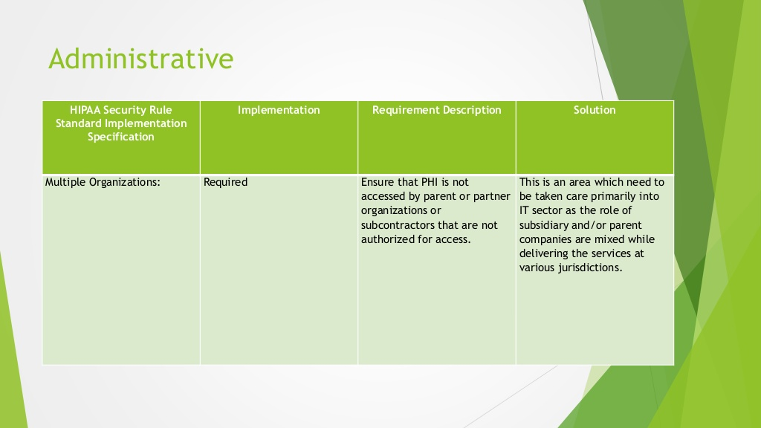
Notes:
Administrative HIPAA Security Rule Standard Implementation Specification Implementation Requirement Description Solution Multiple Organizations: Required Ensure that PHI is not accessed by parent or partner organizations or subcontractors that are not authorized for access. This is an area which need to be taken care primarily into IT sector as the role of subsidiary and/or parent companies are mixed while delivering the services at various jurisdictions.

Slide 23
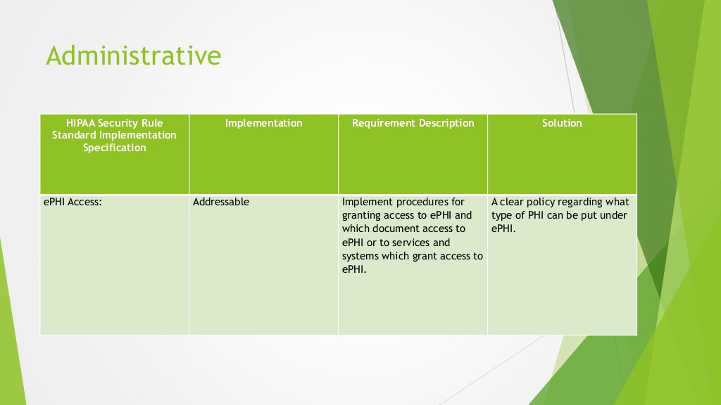
Notes:
Administrative HIPAA Security Rule Standard Implementation Specification Implementation Requirement Description Solution ePHI Access: Addressable Implement procedures for granting access to ePHI and which document access to ePHI or to services and systems which grant access to ePHI. A clear policy regarding what type of PHI can be put under ePHI.

Slide 24
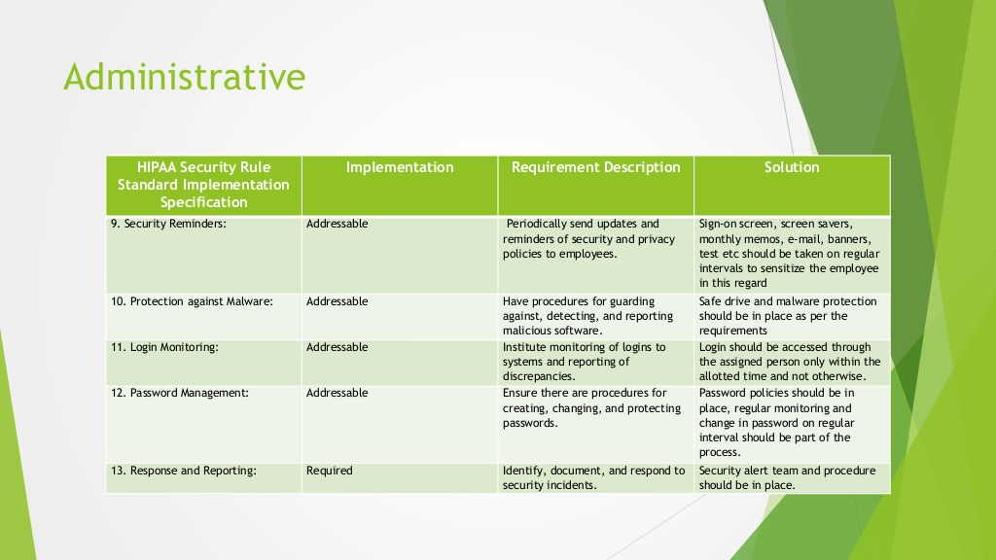
Notes:
Administrative HIPAA Security Rule Standard Implementation Specification Implementation Requirement Description Solution 9. Security Reminders: Addressable Periodically send updates and reminders of security and privacy policies to employees. Sign-on screen, screen savers, monthly memos, e-mail, banners, test etc should be taken on regular intervals to sensitize the employee in this regard 10. Protection against Malware: Addressable Have procedures for guarding against, detecting, and reporting malicious software. Safe drive and malware protection should be in place as per the requirements 11. Login Monitoring: Addressable Institute monitoring of logins to systems and reporting of discrepancies. Login should be accessed through the assigned person only within the allotted time and not otherwise. 12. Password Management: Addressable Ensure there are procedures for creating, changing, and protecting passwords. Password policies should be in place, regular monitoring and change in password on regular interval should be part of the process. 13. Response and Reporting: Required Identify, document, and respond to security incidents. Security alert team and procedure should be in place.

Slide 25
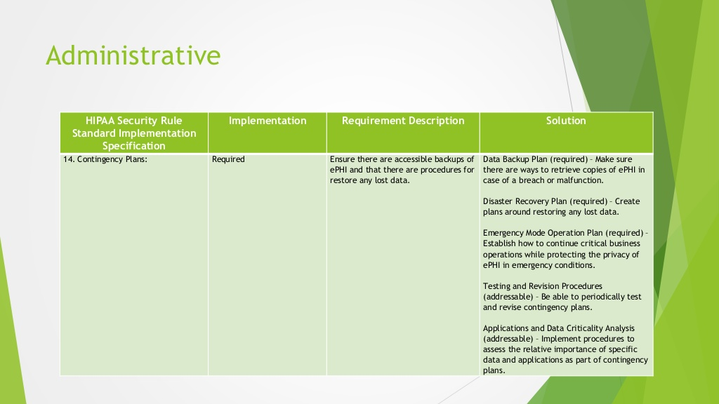
Notes:
Administrative HIPAA Security Rule Standard Implementation Specification Implementation Requirement Description Solution 14. Contingency Plans: Required Ensure there are accessible backups of ePHI and that there are procedures for restore any lost data. Data Backup Plan (required)  Make sure there are ways to retrieve copies of ePHI in case of a breach or malfunction. Disaster Recovery Plan (required)  Create plans around restoring any lost data. Emergency Mode Operation Plan (required)  Establish how to continue critical business operations while protecting the privacy of ePHI in emergency conditions. Testing and Revision Procedures (addressable)  Be able to periodically test and revise contingency plans. Applications and Data Criticality Analysis (addressable)  Implement procedures to assess the relative importance of specific data and applications as part of contingency plans.

Slide 26
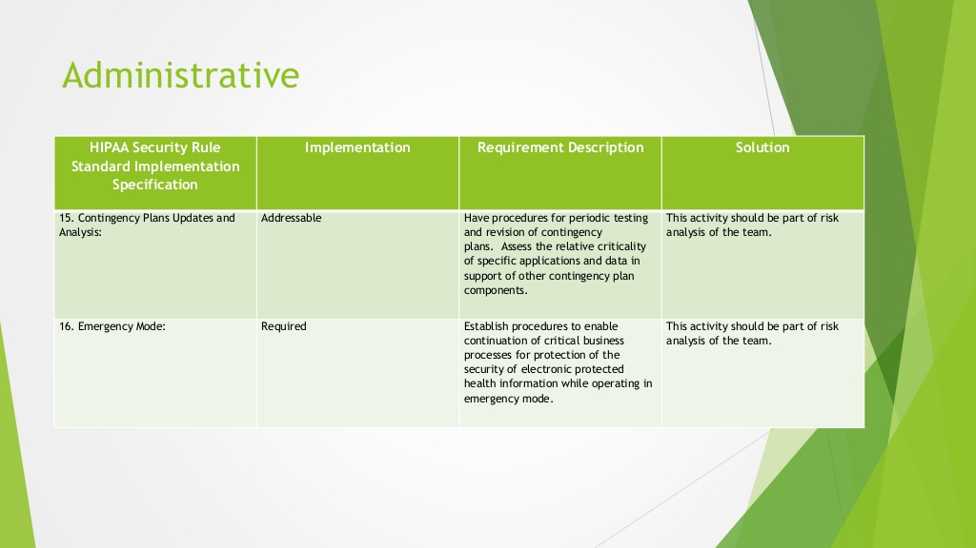
Notes:
Administrative HIPAA Security Rule Standard Implementation Specification Implementation Requirement Description Solution 15. Contingency Plans Updates and Analysis: Addressable Have procedures for periodic testing and revision of contingency plans. Assess the relative criticality of specific applications and data in support of other contingency plan components. This activity should be part of risk analysis of the team. 16. Emergency Mode: Required Establish procedures to enable continuation of critical business processes for protection of the security of electronic protected health information while operating in emergency mode. This activity should be part of risk analysis of the team.

Slide 27
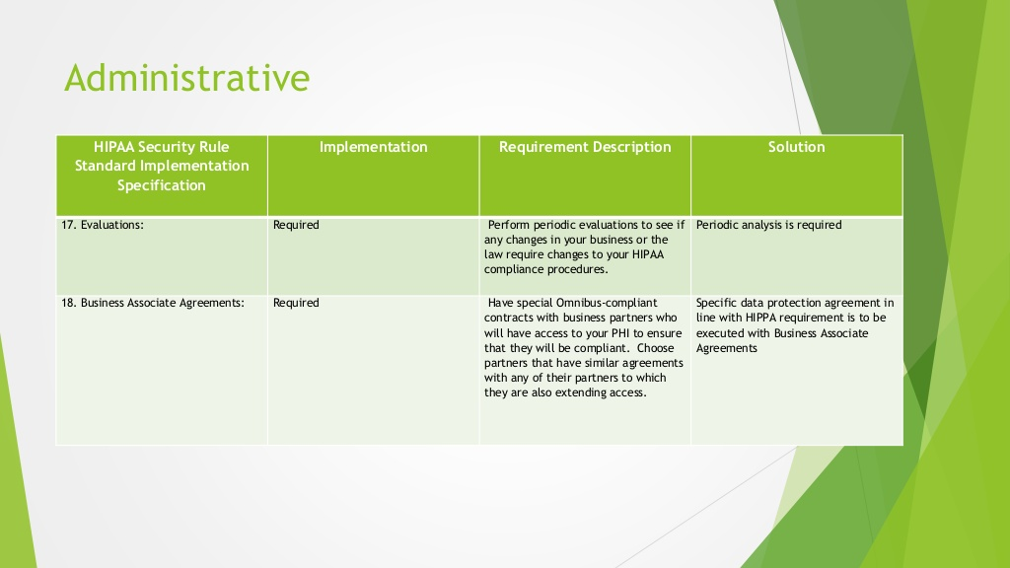
Notes:
Administrative HIPAA Security Rule Standard Implementation Specification Implementation Requirement Description Solution 17. Evaluations: Required Perform periodic evaluations to see if any changes in your business or the law require changes to your HIPAA compliance procedures. Periodic analysis is required 18. Business Associate Agreements: Required Have special Omnibus-compliant contracts with business partners who will have access to your PHI to ensure that they will be compliant. Choose partners that have similar agreements with any of their partners to which they are also extending access. Specific data protection agreement in line with HIPPA requirement is to be executed with Business Associate Agreements

Slide 28
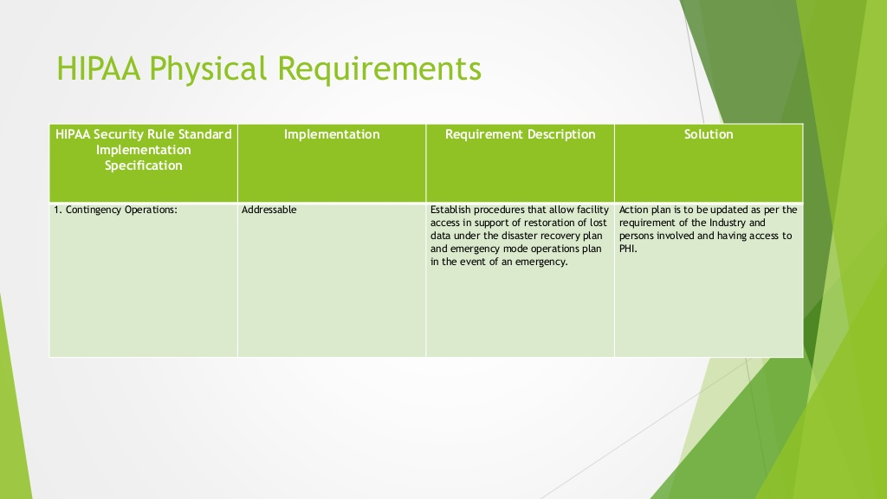
Notes:
HIPAA Physical Requirements HIPAA Security Rule Standard Implementation Specification Implementation Requirement Description Solution 1. Contingency Operations: Addressable Establish procedures that allow facility access in support of restoration of lost data under the disaster recovery plan and emergency mode operations plan in the event of an emergency. Action plan is to be updated as per the requirement of the Industry and persons involved and having access to PHI.

Slide 29
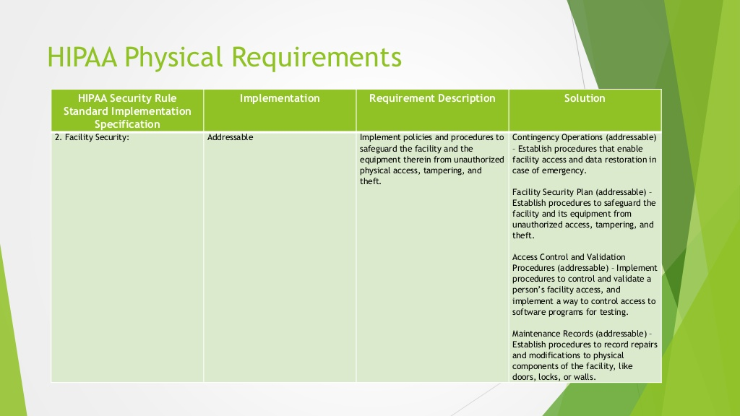
Notes:
HIPAA Physical Requirements HIPAA Security Rule Standard Implementation Specification Implementation Requirement Description Solution 2. Facility Security: Addressable Implement policies and procedures to safeguard the facility and the equipment therein from unauthorized physical access, tampering, and theft. Contingency Operations (addressable)  Establish procedures that enable facility access and data restoration in case of emergency. Facility Security Plan (addressable)  Establish procedures to safeguard the facility and its equipment from unauthorized access, tampering, and theft. Access Control and Validation Procedures (addressable)  Implement procedures to control and validate a persons facility access, and implement a way to control access to software programs for testing. Maintenance Records (addressable)  Establish procedures to record repairs and modifications to physical components of the facility, like doors, locks, or walls.

Slide 30
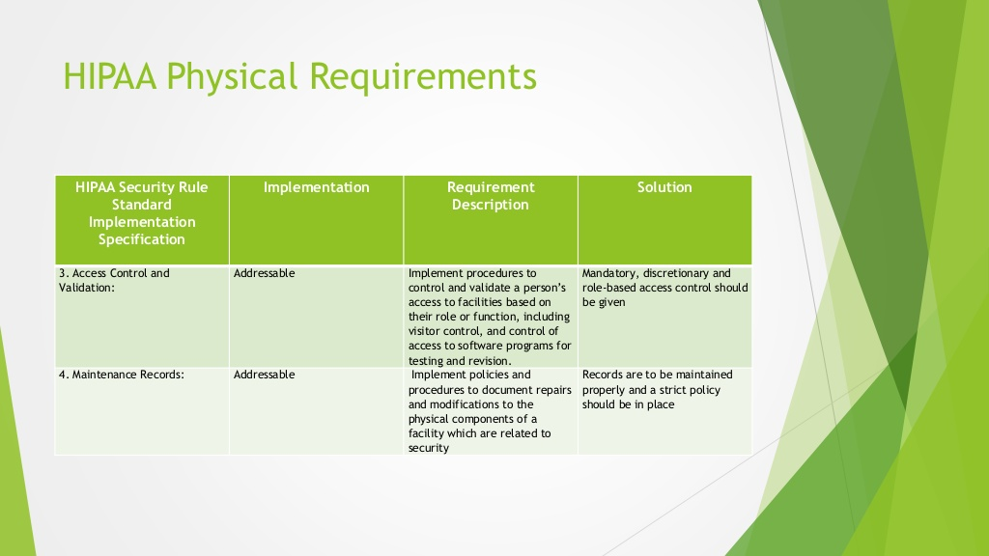
Notes:
HIPAA Physical Requirements HIPAA Security Rule Standard Implementation Specification Implementation Requirement Description Solution 3. Access Control and Validation: Addressable Implement procedures to control and validate a persons access to facilities based on their role or function, including visitor control, and control of access to software programs for testing and revision. Mandatory, discretionary and role-based access control should be given 4. Maintenance Records: Addressable Implement policies and procedures to document repairs and modifications to the physical components of a facility which are related to security Records are to be maintained properly and a strict policy should be in place

Slide 31
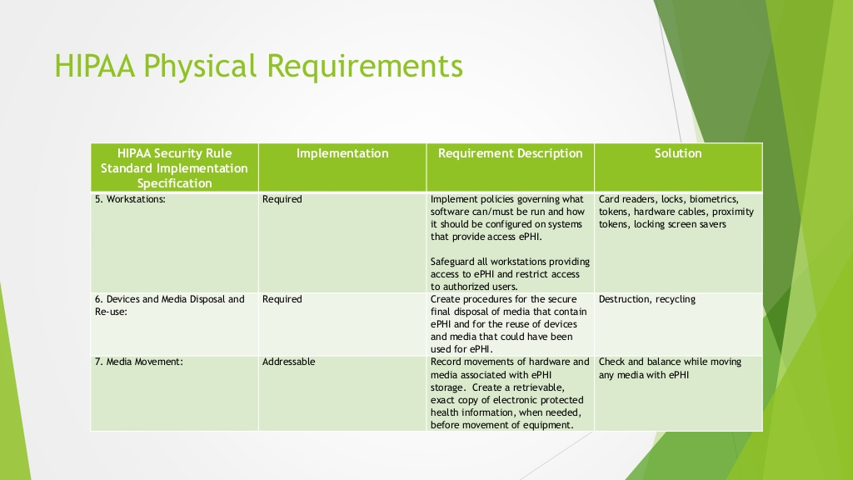
Notes:
HIPAA Physical Requirements HIPAA Security Rule Standard Implementation Specification Implementation Requirement Description Solution 5. Workstations: Required Implement policies governing what software can/must be run and how it should be configured on systems that provide access ePHI. Safeguard all workstations providing access to ePHI and restrict access to authorized users. Card readers, locks, biometrics, tokens, hardware cables, proximity tokens, locking screen savers 6. Devices and Media Disposal and Re-use: Required Create procedures for the secure final disposal of media that contain ePHI and for the reuse of devices and media that could have been used for ePHI. Destruction, recycling 7. Media Movement: Addressable Record movements of hardware and media associated with ePHI storage. Create a retrievable, exact copy of electronic protected health information, when needed, before movement of equipment. Check and balance while moving any media with ePHI

Slide 32
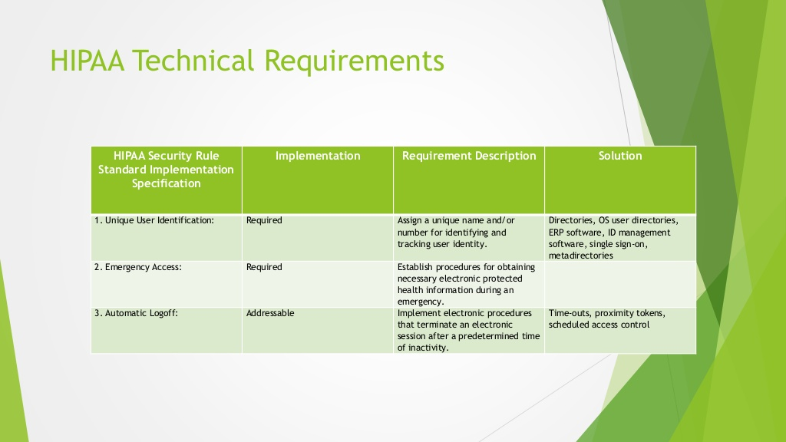
Notes:
HIPAA Technical Requirements HIPAA Security Rule Standard Implementation Specification Implementation Requirement Description Solution 1. Unique User Identification: Required Assign a unique name and/or number for identifying and tracking user identity. Directories, OS user directories, ERP software, ID management software, single sign-on, metadirectories 2. Emergency Access: Required Establish procedures for obtaining necessary electronic protected health information during an emergency. 3. Automatic Logoff: Addressable Implement electronic procedures that terminate an electronic session after a predetermined time of inactivity. Time-outs, proximity tokens, scheduled access control

Slide 33
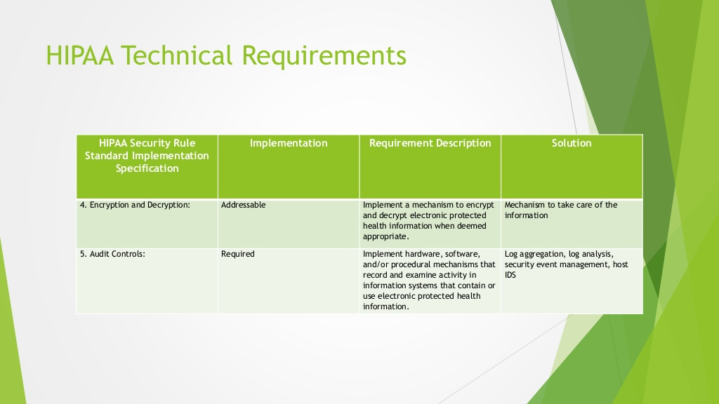
Notes:
HIPAA Technical Requirements HIPAA Security Rule Standard Implementation Specification Implementation Requirement Description Solution 4. Encryption and Decryption: Addressable Implement a mechanism to encrypt and decrypt electronic protected health information when deemed appropriate. Mechanism to take care of the information 5. Audit Controls: Required Implement hardware, software, and/or procedural mechanisms that record and examine activity in information systems that contain or use electronic protected health information. Log aggregation, log analysis, security event management, host IDS

Slide 34
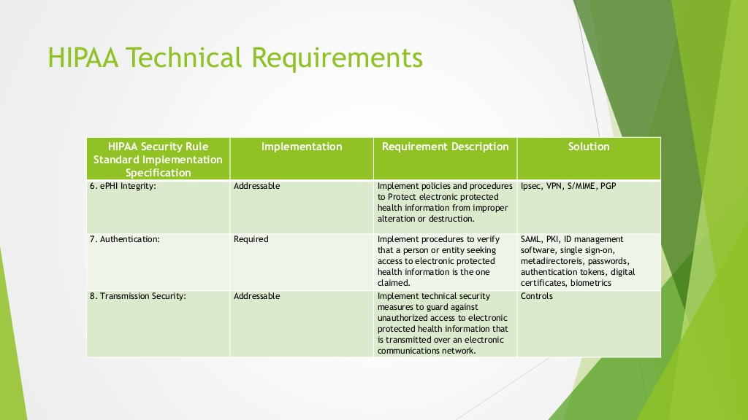
Notes:
HIPAA Technical Requirements HIPAA Security Rule Standard Implementation Specification Implementation Requirement Description Solution 6. ePHI Integrity: Addressable Implement policies and procedures to Protect electronic protected health information from improper alteration or destruction. Ipsec, VPN, S/MIME, PGP 7. Authentication: Required Implement procedures to verify that a person or entity seeking access to electronic protected health information is the one claimed. SAML, PKI, ID management software, single sign-on, metadirectoreis, passwords, authentication tokens, digital certificates, biometrics 8. Transmission Security: Addressable Implement technical security measures to guard against unauthorized access to electronic protected health information that is transmitted over an electronic communications network. Controls

Slide 35
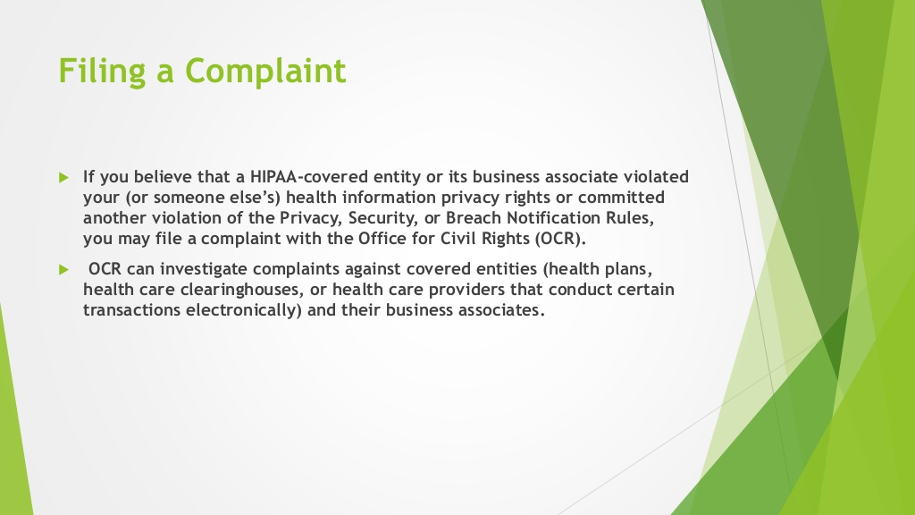
Notes:
Filing a Complaint ïµ If you believe that a HIPAA-covered entity or its business associate violated your (or someone elses) health information privacy rights or committed another violation of the Privacy, Security, or Breach Notification Rules, you may file a complaint with the Office for Civil Rights (OCR). ïµ OCR can investigate complaints against covered entities (health plans, health care clearinghouses, or health care providers that conduct certain transactions electronically) and their business associates.

Slide 36
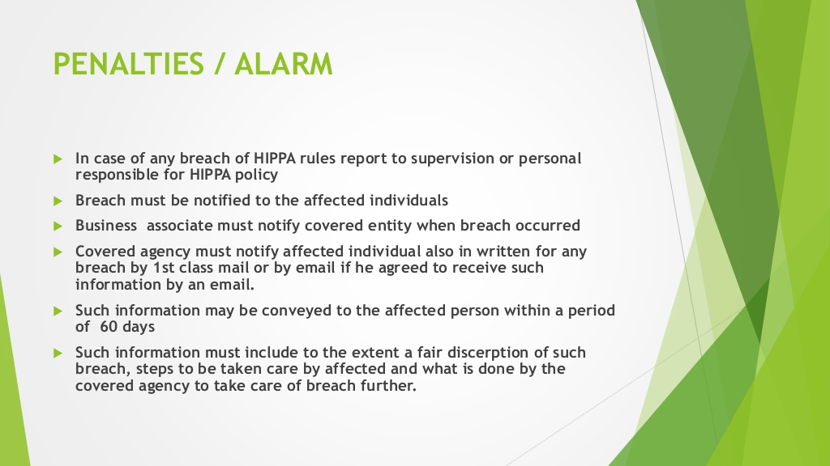
Notes:
PENALTIES / ALARM ïµ In case of any breach of HIPPA rules report to supervision or personal responsible for HIPPA policy ïµ Breach must be notified to the affected individuals ïµ Business associate must notify covered entity when breach occurred ïµ Covered agency must notify affected individual also in written for any breach by 1st class mail or by email if he agreed to receive such information by an email. ïµ Such information may be conveyed to the affected person within a period of 60 days ïµ Such information must include to the extent a fair discerption of such breach, steps to be taken care by affected and what is done by the covered agency to take care of breach further.

Slide 37
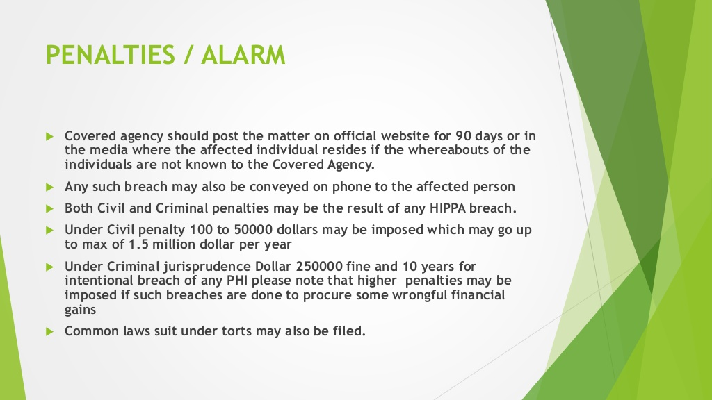
Notes:
PENALTIES / ALARM ïµ Covered agency should post the matter on official website for 90 days or in the media where the affected individual resides if the whereabouts of the individuals are not known to the Covered Agency. ïµ Any such breach may also be conveyed on phone to the affected person ïµ Both Civil and Criminal penalties may be the result of any HIPPA breach. ïµ Under Civil penalty 100 to 50000 dollars may be imposed which may go up to max of 1.5 million dollar per year ïµ Under Criminal jurisprudence Dollar 250000 fine and 10 years for intentional breach of any PHI please note that higher penalties may be imposed if such breaches are done to procure some wrongful financial gains ïµ Common laws suit under torts may also be filed.

